Slide 1
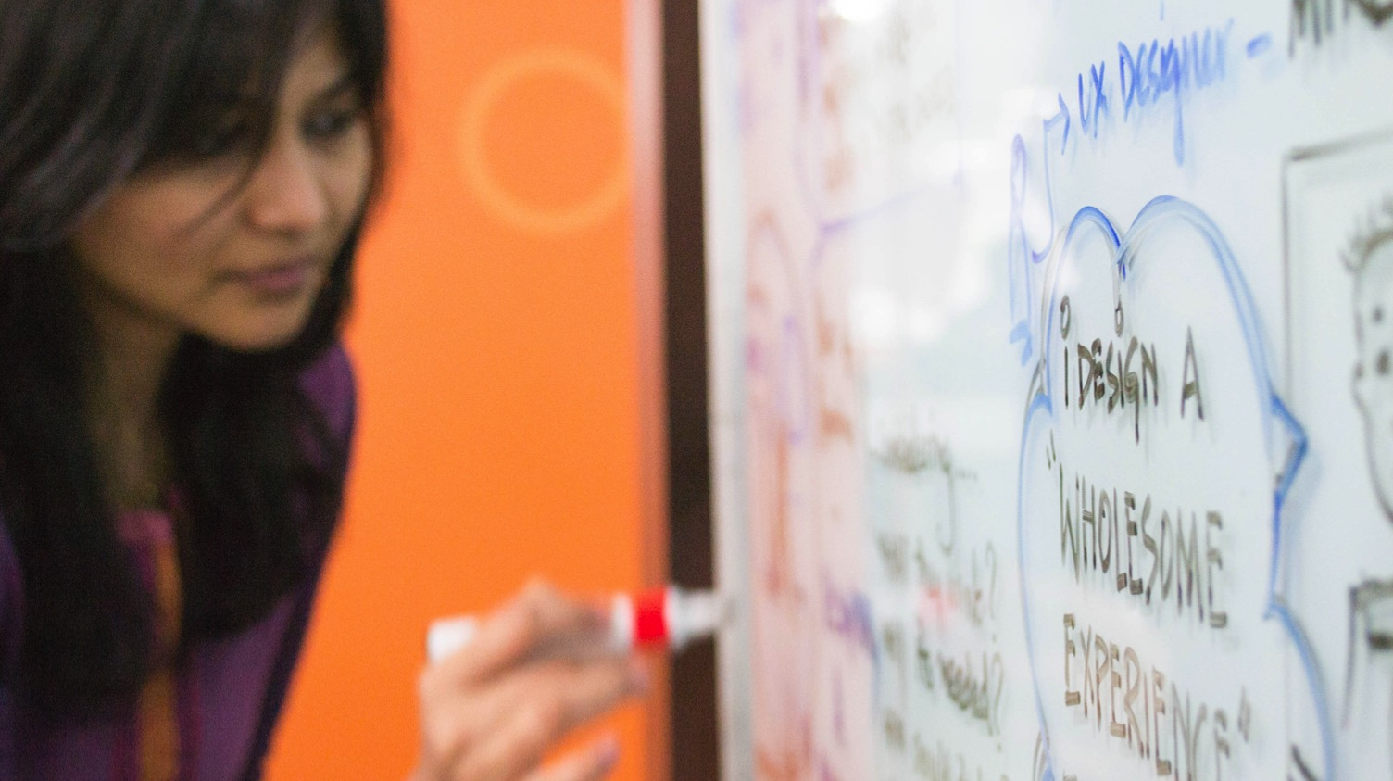
National Youth Leadership Forum on Engineering & Technology
Dr. James F. Walsh, CTO
June 21, 2016
UC Berkeley

Slide 2

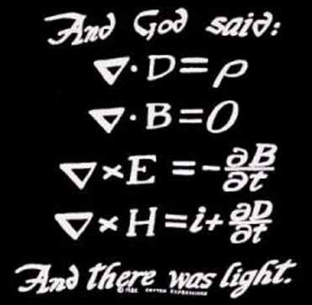
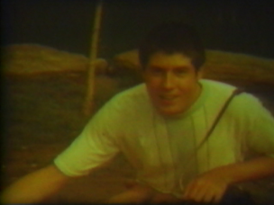
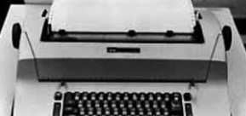
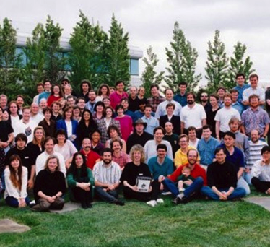
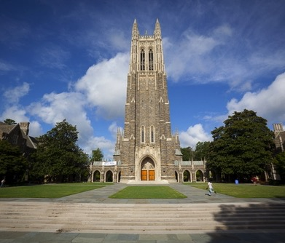



What do I do today?
“When I was your age…”
Getting started in software in 1982
The Steve Jobs Years
The next 30 years—what to expect for your career
Lessons learned
Q & A

Slide 3
What do I do today?

Slide 4
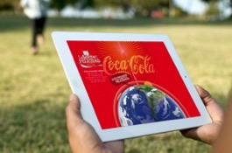
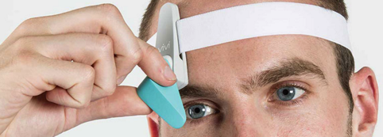
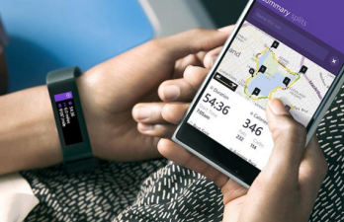
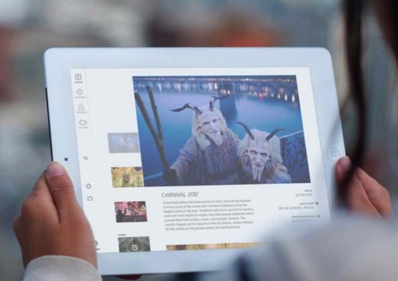

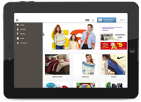




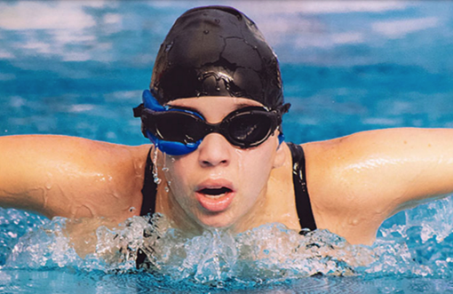
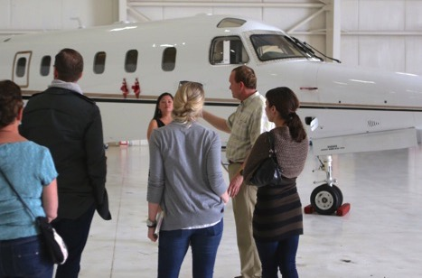
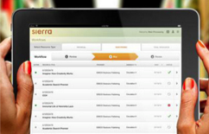
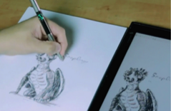

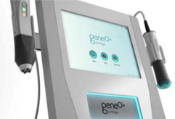
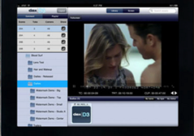
14 Product Engineering Centers
3 Experience Design Studios
14 Sales Offices
9500+ employees in 10 countries
62 ongoing innovation labs
1500+ projects delivered p/year
Touching how people live, work, play, consume and interact
GlobalLogic Confidential

Slide 5
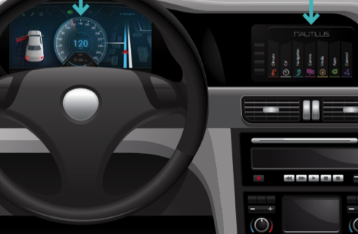



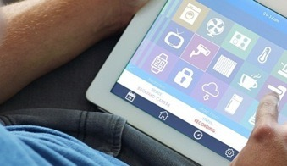
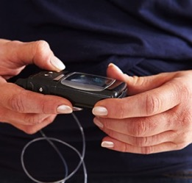
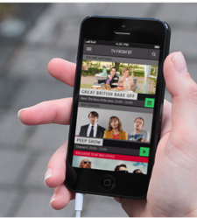
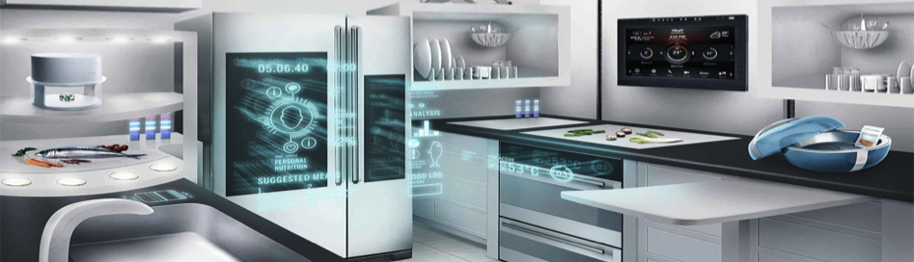


We make stuff for cars, including work on self driving cars
Mobile and Security
Cloud technology
The Internet of Things
Dev Ops, Embedded,
Big Data and Analytics,

Slide 6
What does a CTO do?
CTO = “Chief Technology Officer”
One of the company’s top EXECUTIVES
ADVISE the rest of EXECUTIVE TEAM on technology trends affecting the company
LEAD advanced technology / R&D initiatives
I TRAVEL a LOT
I help our customers INVENT STUFF
Look at the “NEXT GENERATION” of products and services
Help attract and grow top technology TALENT
ADVISE strategic CUSTOMERS and prospects on products and technologies
COMMUNICATE company’s technology message to the market
June 21, 2016

Slide 7
What does a CTO do?
CTO = “Chief Technology Officer”
One of the company’s top EXECUTIVES
ADVISE the rest of EXECUTIVE TEAM on technology trends affecting the company
LEAD advanced technology / R&D initiatives
I TRAVEL a LOT
I help our customers INVENT STUFF
Look at the “NEXT GENERATION” of products and services
Help attract and grow top technology TALENT
ADVISE strategic CUSTOMERS and prospects on products and technologies
COMMUNICATE company’s technology message to the market
June 21, 2016

Slide 8
“When I was your age. . .”

Slide 9
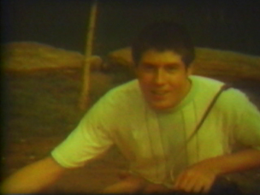
What I was like in High School
Interests / Activities
Speech, Drama & Debate
Music (singing & piano)
Photography (camera & darkroom; 8mm movies)
Football & Track
Science Fiction
Computers
Science: Chemistry, Biology, Physics
Tech: Space, Electronics
Girls / Dating
(Me at about age 16; Photo courtesy Jim Walsh)
June 21, 2016

Slide 10
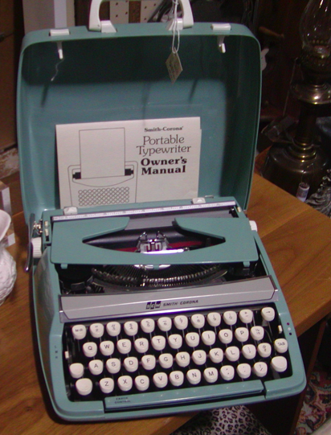
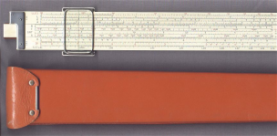
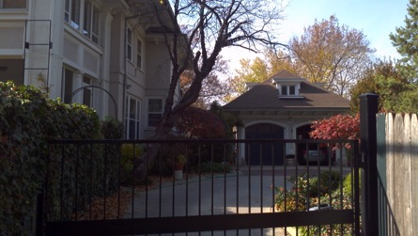
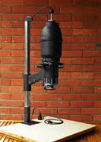
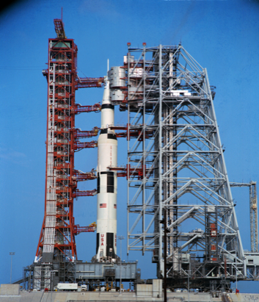
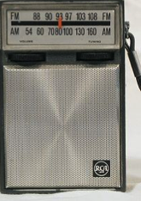
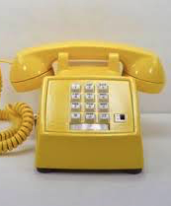
Things around me (early 1970’s)
My house growing up in Kansas City Missouri (photo courtesy Jim Walsh)
K&E Log Duplex Decitrig (photo courtesy of www.sliderule.ca)
Transistor radio (photo courtesy Pinterest)
Apollo Moon Launches (photo courtesy NASA)
Smith Corona mechanical
typewriter (Photo courtesy of
onlineditto.wordpress.com)
Photo enlarger (photo courtesy camera-wiki.org)
June 21, 2016

Slide 11
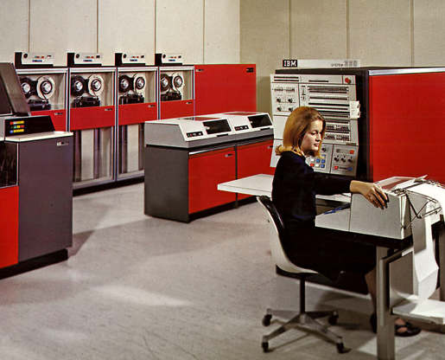
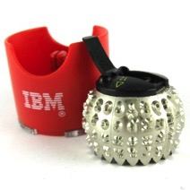
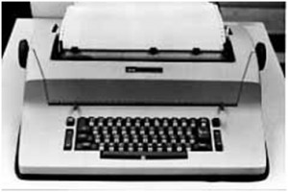
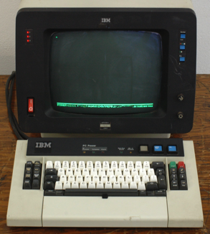
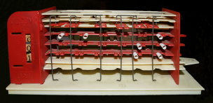
The very first digital computers I programmed (about 1972)
IBM 1050 and 2741 terminals with APL Selectric “ball”
(courtesy http://www.computerhistory.org/)
IBM 3277 terminal, used for APL/360 (image courtesy wikipedia.org)
“Digicomp” Toy (courtesy of www.wikipedia.org)
IBM System 360 (image courtesy ibm.com)

Slide 12
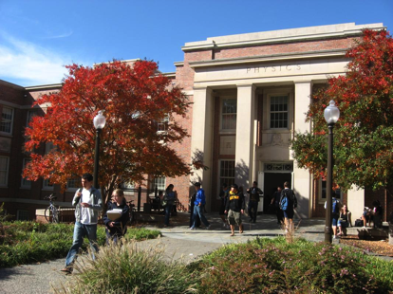
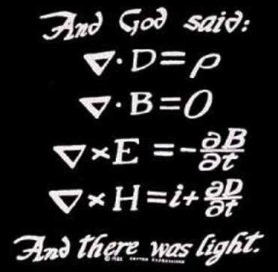
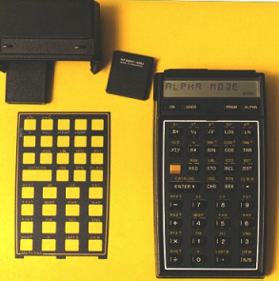
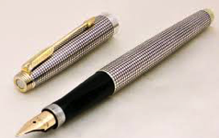
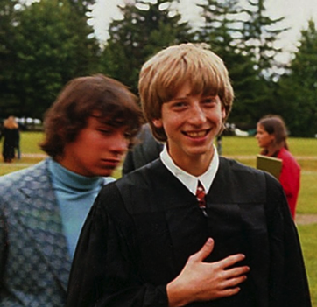
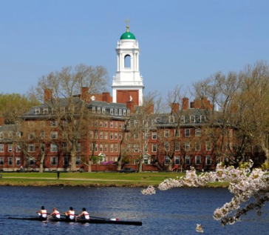
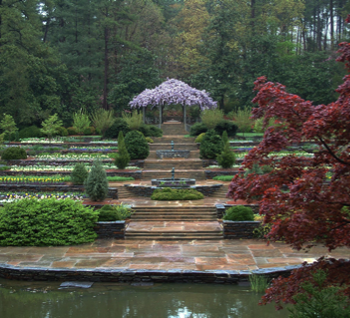
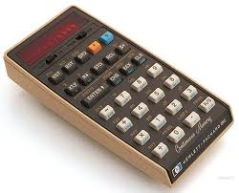
Things around me (late 1970’s)
Parker 75 fountain pen (courtesy reddit)
Bill Gates, mid 1970’s. He was a year ahead of me at Harvard (photo courtesy www.businessinsider.co.id)

Slide 13










A few of the big companies I’ve worked with or for

Slide 14
Getting started in software (1982), and my career since

Slide 15
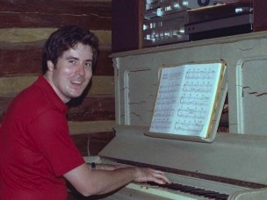
In 1982 I was a Physics grad student at Duke
Activities
Recently married (1981)
Just received my Masters degree in Physics
Worked as a teaching assistant (TA) for my professor, helping teach undergrad Physics
Research focused on theoretical high-energy particle physics
Began writing my thesis on “A non-relativistic formulation of the MIT Bag Model of Hadron Masses”
Enjoyed: music, science fiction, travel!
June 21, 2016

Slide 16
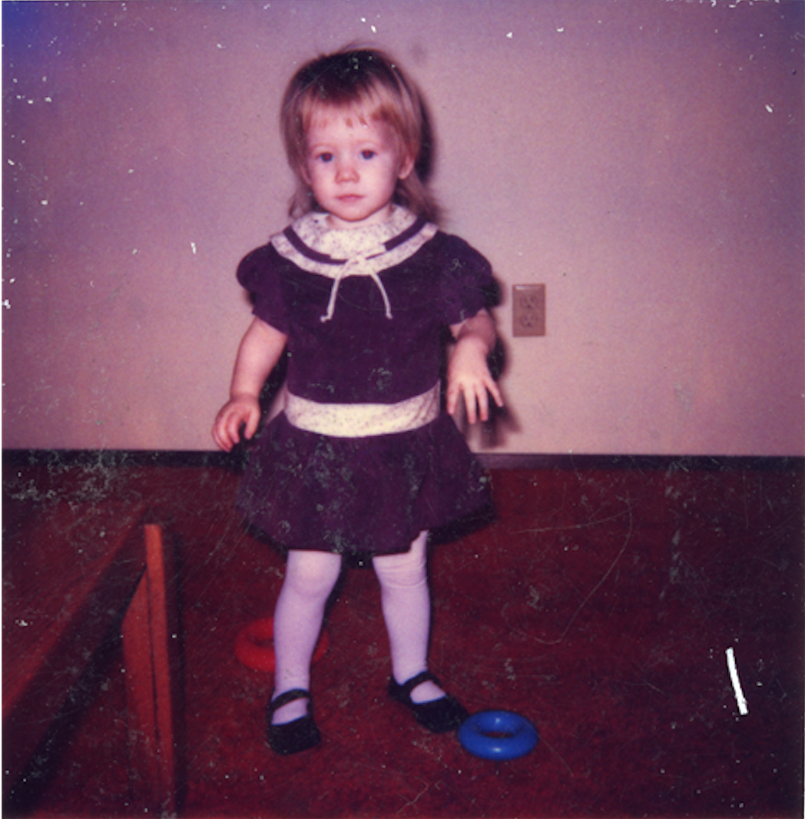
In 1982 we learned we had a baby on the way
Anna Walsh
Born in 1983!
June 21, 2016

Slide 17
An easy decision (for me) to make:
Grad student
Start developing software for one of my father’s law clients
$443 per month as a TA
($1.1k/month today)
Stay in academics & develop further as a physicist / scientist
Maybe win a professorship or a Nobel prize some day—but in the meantime struggle financially
$25/hour for me ($62/hour today) AND for each of my employees (…of which I kept a cut), plus expenses
Take what I’ve learned in school and develop myself as a business person and problem solver
Raise a family
OR
June 21, 2016

Slide 18
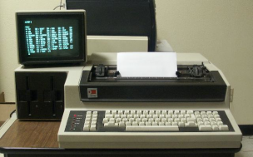
I went with the software option—
a loaner computer came with the deal!
June 21, 2016

Slide 19
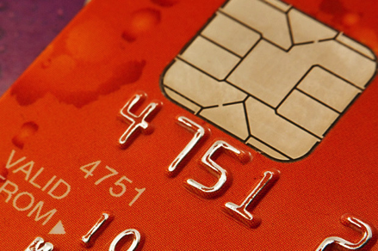
My 1982 computer compared to a bank card now
1982
2016
$32,000 (*)
$0.75
Durango F-85. Intel 8085 8-bit, 5 Mhz microprocessor, 64K RAM. (Photo courtesy sydex.com)
(*) is in 2016 ‘equivalent’ dollars; cost was actually $13K in 1982
NXP MIFARE DESFire EV1 Chip card with Intel 8051-based 8-bit 12+ MHz processor; 8k NV-RAM, 80k EEPROM, 264kb ROM
June 21, 2016

Slide 20
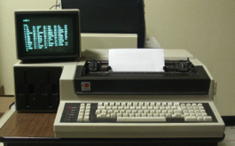

My 1982 computer compared to a 15” MacBook Pro
> 1 million times more capable (per dollar)
By comparison!
$32,000 (in 2016 dollars)
CPU: 8 bit, 5 Mhz
(~0.5 MIPS)
RAM: 64 kB
Mass Storage: 40 Mb (HD), plus 960k x 2 removable
Display: 9”, 80 characters by 24 rows; 1 color
$2,999
CPU: 64 bit, 2.5 GHz, quad-core (~250k MIPS)
RAM: 16 GB
Mass Storage:
1 Tb (SSD)
Display: 15.4”, 2880x1800 pixels (220 pixels/inch), full color
10x cheaper
~500k x
faster
250k x storage
70%
larger display
~270x (x3) more pixels
June 21, 2016

Slide 21








My career
Startup / Pre-public company
Neural network speech recognition startup
MS2
Outcome
Started “CustomSoft”
Logisticon
1981
1982
1983
1985
1989
1991
1993
1998
2000
2002
2004
2009
Present
Masters in Physics
Oldest daughter born
Ph.D in Physics
Youngest daughter born
May 26, 2016
Notes:
34 working years so far
Have worked for 11 companies, 8 of which (73%) were startups or “non-public”
2 startups / private companies have gone public while I was there
The bulk of my career (25 / 34 = 73%) has been with 4 companies
CustomSoft (7 years)
NeXT / Apple (5.5 years)
Chordiant (5 years)
GlobalLogic (7.5 years so far)

Slide 22
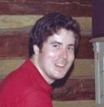
Why did I make these career decisions?
Started a family
Excited about technology and opportunity
Restart / Startup failed
Closer to home: earthquake!
Liked the people, thought I could learn!
Grad student
CustomSoft 7 years
Neural Networks/speech recognition
Borland
6 months
Logisticon
1.5 years
Rational
1.5 years
1-2 years while at CustomSoft
NeXT / Apple
5.5 years
MS2
2 years
Outcome
1.5 years
E.Piphany
1 year
Chordiant
5 years
GlobalLogic
7.5 years
Liked the people, thought I could learn!
Money
Excited about technology and opportunity
Restart / Startup failed
Liked the people, thought I could learn!
Liked the people, thought I could learn!
May 26, 2016

Slide 23
A few job titles and roles I’ve had
President / “Principal”
Director, Network Applications Development
Director of Quality, Process and Test
CTO
Manager of Current Product Engineering
Architect
Designer
Head of IT & Enterprise Applications Development
Head of User Experience Design
Software Engineer
Director, DevOps
Head of Technical Writing
Acting Head of Product Support
VP Engineering
Director, Web Applications Development
VP Offshore Product Development
Sales & Technical Sales Support
Product Owner / Product Manager
Consultant
May 26, 2016

Slide 24
The Steve Jobs | NeXt era
(1993-1998)

Slide 25
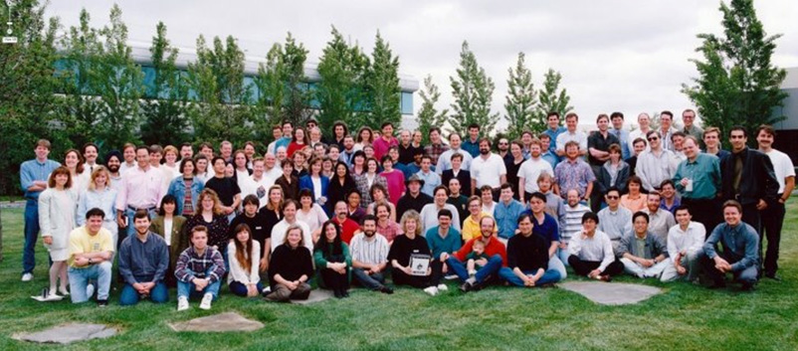

NeXT | Apple Years
Me
NeXT Software, 1993
Steve Jobs
(NeXT Logo Courtesy wikipedia.org)

Slide 26


How I first met Steve Jobs

Slide 27






Steve Jobs | Apple Timeline
1993
ME
1998
Jobs leaves
Apple, founds
NeXT
Jobs becomes Apple CEO
Apple ships first iPhone
Steve Jobs dies at age 56
1976
1985
1996
1997
2001
2007
2010
2011
Apple
Founded
Apple buys
NeXT
Apple ships first iPod
Apple ships first iPad
May 26, 2016

Slide 28

The Steve Jobs I knew
Management
Surround yourself with “A” players
  Work with only the best people you can find: “A players attract A players; B players attract C players”
  Challenge people
  Set big goals and empower people so they can meet them
  Don’t micromanage
Set and insist on a “high bar”
  Insist on a high standard of achievement
  When something doesn’t measure up or isn’t right, say so
May 26, 2016

Slide 29

The Steve Jobs I knew
Personal
Cultivate great taste
  Learn to recognize and appreciate what’s good
  —not just in technology
Remain human
  “Famous brother”
Love what you do
  “If today was my last day…”
May 26, 2016

Slide 30
The next 30 years –
what to expect for your career

Slide 31



Trends that will shape the next 30 years
Ubiquitous compute power
Software control over material objects
Cognitive computing / intelligent agents
Photo courtesy of: http://dekhomobile.blogspot.com/2011/11/latest-glass-mobile-phone-latest-mobile.html
Photo courtesy of : www.elsevier.com
Photo courtesy of : http://www.earley.com/sites/default/files/artificial-intelligence-robot-head.jpg
June 21 2016

Slide 32

Ubiquitous compute power
In 30 years your phone will have more compute power than Google’s entire global network did 3 years ago
Disposable computers (exist today: MIFARE Ultralight)
Compute and display power embedded in nearly every surface
Compute power and connectivity embedded in almost every device
Amazing games, simulations, new interaction models
Implantable devices / direct brain connections
Seamless connect between physical and virtual world; the two are completely merged
June 21 2016
Notes:
A very small part of Google’s multi-billion dollar global infrastructure, estimated in 2012 at two million “average sized” quad-core machines. (Image Courtesy Wired.com )
Disposable computers (exist today: MIFARE Ultralight)
Compute and display power embedded in nearly every surface
Compute power and connectivity embedded in almost every device
Amazing games, simulations, new interaction models
Implantable devices / direct brain connections
Seamless connect between physical and virtual world; the two are completely merged

Slide 33

Software control over material objects
Just-in-time production of clothing, furniture and other goods
“Internet of Things” (IoT)
Robots; autonomous vehicles and other systems
Printing human organs
Computer-assisted organic synthesis of molecules
Individual medications and custom viruses to connect genetic issues
“Growing” macro-structures under software control using molecular nanotechnology
Automated DNA Synthesis
(photo courtesy harvard.edu)
3D printing
(photo courtesy elsevier.com)
June 21 2016
Notes:
A very small part of Google’s multi-billion dollar global infrastructure, estimated in 2012 at two million “average sized” quad-core machines. (Image Courtesy Wired.com )
Disposable computers (exist today: MIFARE Ultralight)
Compute and display power embedded in nearly every surface
Compute power and connectivity embedded in almost every device
Amazing games, simulations, new interaction models
Implantable devices / direct brain connections
Seamless connect between physical and virtual world; the two are completely merged

Slide 34
Cognitive computing
We already have learning systems that summarize information, write reports, make inferences and diagnoses
Intelligent agents
Information-based businesses (Uber, AirBnB, etc)
Human-scale intelligence can be modeled at a price that’s affordable for small business in 30 years
Higher and higher level goal-seeking languages, with compute power filling in the blanks
Photo courtesy of : http://www.earley.com/sites/default/files/artificial-intelligence-robot-head.jpg
June 21 2016

Slide 35
Careers
Mapping what people need to what machines can do
Designer
Architect
Product Manager
Product Marketing
Biomedicine:
Research into drug interactions
Game designer
Story teller
Movie maker”
Teachers / Trainers
Managers of Cognitive Computing systems
Data Science
Making human sense of complex information
June 21 2016
Notes:
Positions being redefined all the time! Definitions and models constantly evolving.

Slide 36
Lessons learned

Slide 37

Learn how to learn
In a time of constant change, the ability to learn is more important than what you already know
Photo courtesy of : http://news.mit.edu/2012/graduate-student-david-sengeh-gives-back-to-sierra-leone-1218
Notes:
David Moinina Sengeh considers himself a lucky man — and one who feels the importance of living every day to the fullest. During Sierra Leone’s fierce civil war, as bands of child-soldiers roamed the country committing murder and mayhem, he and his parents and four siblings escaped unharmed.
But his family and friends were not entirely unscathed: Two uncles were brutally killed, and a stray bullet killed a girl who lived next door. “Anybody who lived in Sierra Leone got affected by the war,” says Sengeh, now a doctoral student at the MIT Media Lab.
At the Media Lab, Sengeh is working to improve prosthetic limbs. In Sierra Leone — where amputations were used to instill fear during the civil war — many people don’t wear their prosthetic limbs because the hard plastic sockets don’t fit well. Sengeh has been working to produce custom-fitted, yet affordable, sockets.
.

Slide 38

Listen
No one will listen to your solution until they know you understand their problem.
Photo courtesy of : http://english.sina.com/world/p/2009/0204/215920.html
Notes:
An African tribal leader attends a news conference at the 12th African Union Summit in Ethiopia's capital Addis Ababa, February 3, 2009. [Xinhua/Xu Suhui]

Slide 39

College
Your college years should be about more than studying
Photo courtesy of : http://media.nola.com/living_baton_rouge/photo/habitat-for-humanity-a75803b7cdd062e8.jpg

Slide 40


Your value
Recognize what you’re good at, and put yourself in a place where that is valued
Photo courtesy of : http://http://www.calder.org/life/photobiography
Photo courtesy of : https://www.theguardian.com/artanddesign/2015/jul/14/alexander-calder-mobile-art-tate-retrospective
Notes:
Alexander Calder “Mobile Technology” : recognized as the “father of Mobiles”, Alexander Calder so enchanted Albert Einstein that the scientist stood gazing at one for 45 minutes. Mobile is a hybrid of “motion” and “motive” in French.
Calder developed mobiles that responded to air currents, light, humidity, and human interaction.
In this photo, Calder is installing International Mobile, Third International Exhibition of Sculpture, Philadelphia Museum of Art, 1949. Photography by Herbert Gehr
http://www.calder.org/work/by-life-period/1946-1952

Slide 41

Make conscious decisions
Don’t go on autopilot. You’ll have fewer regrets
If I do X
Pros
Cons
If I don’t do X
Pros
Cons
Photo courtesy of : Shutterstock images

Slide 42

Regrets
Short term, you regret what you do
Long term, you regret what you didn’t do
Photo courtesy of : Shutterstock images

Slide 43

“Engineers can change people’s lives and are among the key people in the world”
- Jerry Wozniak
(Steve Wozniak’s Dad)
Aerospace engineer, Lockheed
Photo courtesy of : http://media.nola.com/living_baton_rouge/photo/habitat-for-humanity-a75803b7cdd062e8.jpg

Slide 44
Questions?

